Slide 1


System Hacking
by Gerald Suleh

Slide 2
Objectives
Discuss System Hacking Concepts.
Describe the Certified Ethical Hacker hacking methodology.
Explain the different techniques to gain access to a system.
Discuss privilege escalation techniques.
Discuss different techniques to gain and maintain remote access to a system.
Discuss different techniques to hide the evidence of compromise.
Apply various system hacking countermeasures.

Slide 3
What is System Hacking?

Slide 4
Introduction
It is one of the most important, and sometimes, the ultimate goal of an attacker.
It involves techniques such as footprinting, scanning, enumeration, and vulnerability analysis.
Uses the information gathered to hack the target system.
“System hacking is the process of exploiting vulnerabilities in electronic systems for the purpose of gaining unauthorized access to those systems.”

Slide 5
System Hacking Concepts
An attacker engages in system hacking attempts using Information collected in earlier footprinting, scanning, enumeration, and vulnerability analysis phases.
The following is an overview of these phases and the information collected so far.

Slide 6
Footprinting
Footprinting is the process of accumulating data about a specific network environment.
In the footprinting phase, the attacker creates a profile of the target organization and obtains information such as its IP address range, namespace, and employees.

Slide 7
Scanning
Scanning is a procedure used for identifying active hosts, open ports, and unnecessary services enabled on particular hosts.
Types of scanning:
port scanning.
network scanning.
vulnerability scanning
Scanning procedures such as port scanning and ping sweeps return information about the services offered by the live hosts that are active on the Internet, and their IP addresses.

Slide 8
Enumeration
Enumeration is a method of intrusive probing, through which attackers gather information such as network user lists, routing tables, security flaws, and Simple Network Management Protocol (SNMP) data.
Enumeration involves making active connections to the target system or subjecting it to direct queries.
Normally, an alert and secure system logs such attempts. Often, the information gathered, such as a DNS address, is publicly available.

Slide 9
Vulnerability Analysis
Vulnerability assessment is an examination of the ability of a system or application, including its current security procedures and controls, to withstand assault.
Attackers perform vulnerability analysis to identify security loopholes in the target organization’s network, communication infrastructure, and end systems.

Slide 10
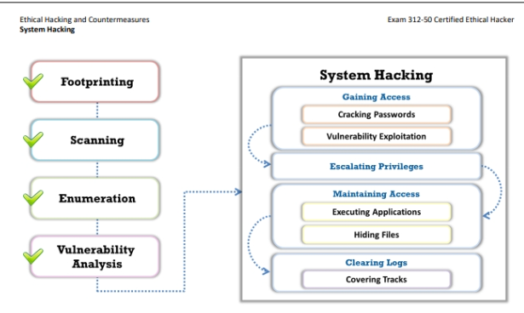
CEH Hacking Methodology

Slide 11
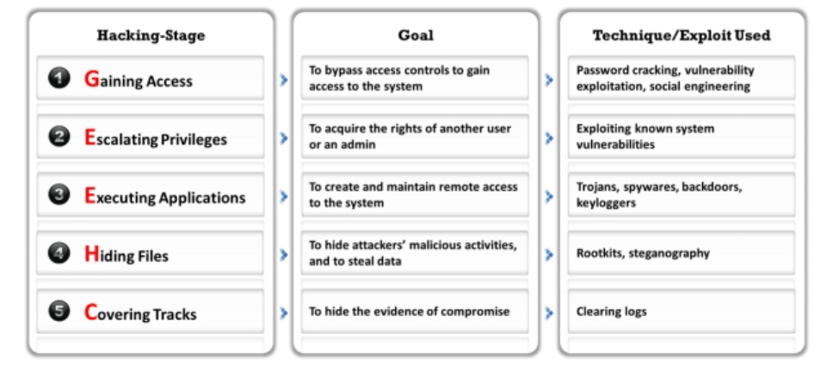
System Hacking Goals

Slide 12
System Hacking Steps
Gaining Access
The attacker first tries to gain access to a target system using information obtained and loopholes found in the access control mechanism of the system. The attacker can then use techniques such as password cracking, vulnerability exploitation, and social engineering tactics to gain access to the target system.
Escalating Privileges
After gaining access to a system using a low-privileged normal user account, the attacker may then try to increase their administrator privileges to perform protected system operations, so that they can proceed to the next level of the system hacking phase, which is the execution of applications.

Slide 13
System Hacking Steps
Executing Applications
Once the attacker has administrator privileges, they can attempt to install malicious programs such as Trojans, backdoors, rootkits, and keyloggers, which grant them remote system access and enable them to remotely execute malicious codes.
Hiding Files and Covering Tracks
Attackers use rootkits and steganography techniques to attempt to hide the malicious files they install on the system, and thus their activities. To remain undetected, it is important for the attackers to erase from the system all evidence of security compromise. To achieve this, they might modify or delete logs in the system using certain log-wiping utilities.

Slide 14
Gaining Access Via Password Cracking
Password cracking is the process of recovering passwords from the data transmitted by a computer system or from the data stored in it.
The purpose of cracking a password include;
password recovery.
preventive measure by system administrators to check for easily breakable passwords.
gain unauthorized system access.

Slide 15
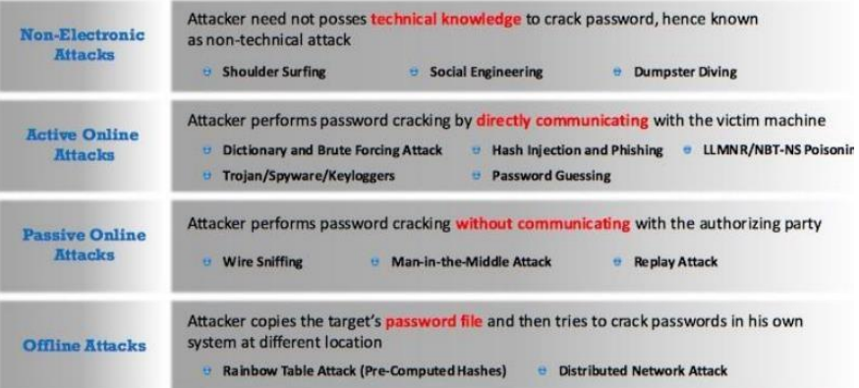
Types Of Password Attacks

Slide 16
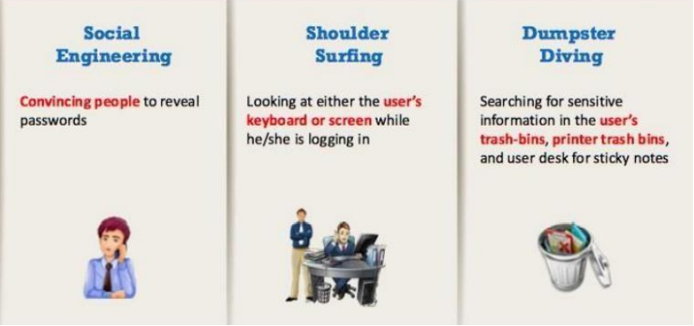
Non-Electronic Attacks
The attacker does not need to have technical knowledge to crack/get a password (non-technical attack.

Slide 17
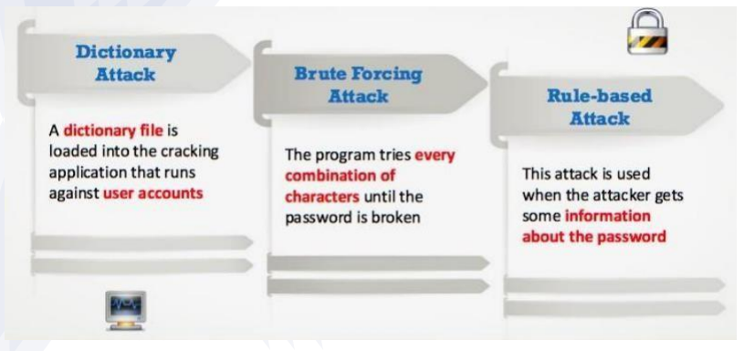
Active Online Attack
The attacker performs password cracking by directly communicating with the victim.

Slide 18
Passive Online Attack
Wire Sniffing
Packet sniffing is a form of wire sniffing or wiretapping in which hackers sniff credentials during transit by capturing Internet packets.
Attackers rarely use sniffers to perform this type of attack. With packet sniffing, an attacker can gain passwords to applications such as email, websites, SMB, FTP, rlogin sessions, or SQL.
As sniffers run in the background, the victim remains unaware of the sniffing.

Slide 19
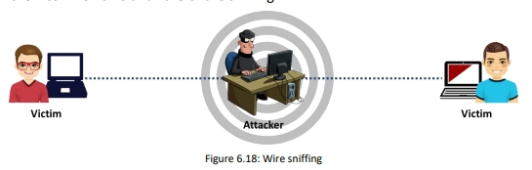
Windows 10 Upgrade Steps

Slide 20
Passive Online Attack
Man-In-The-Middle-Attacks
When two parties are communicating, a man-in-the-middle (MITM) attack can take place, in which a third party intercepts a communication between the two parties without their knowledge.
The third party eavesdrops on the traffic and then passes it along. To do this, the “man in the middle” has to sniff from both sides of the connection simultaneously.
In an MITM attack, the attacker acquires access to the communication channels between the victim and server to extract the information. This type of attack is often used in telnet and wireless technologies.

Slide 21
Windows 10 Upgrade Steps

Slide 22
Offline Attack
Rainbow Tables
Offline attacks occur when the intruder checks the validity of passwords. He/she observes how the password is stored. If the usernames and passwords are stored in a readable file, it becomes easy for the attacker to gain access to the system.
Two examples of offline attacks are as follows:
Rainbow table attack.
Distributed Network Attack.

Slide 23
Microsoft Authentication
Windows operating system authenticates its users with the help of three mechanisms:
Security Account Manager (SAM) database
NTLM authentication
Kerberos Authentication

Slide 24
Gaining Access Via Publicly Available Exploits
Vulnerability: A weakness or flaw in a system. (CVE)
Exploit: Piece of code that takes advantage of a vulnerability in the system to
achieve an unintended or unanticipated behaviour. (MS..-...)
Payload: an action that we want to perform after we exploit a vulnerability. I.E
Execute a code.
Spawn a reverse shell.
Create a backdoor.
Create a user.
Read a file.
Listening Server/Service: A server or service that is configured to wait for connection. (TCP/UDP)
(-l listening mode, -v add verbosity, -p specify port no.)

Slide 25
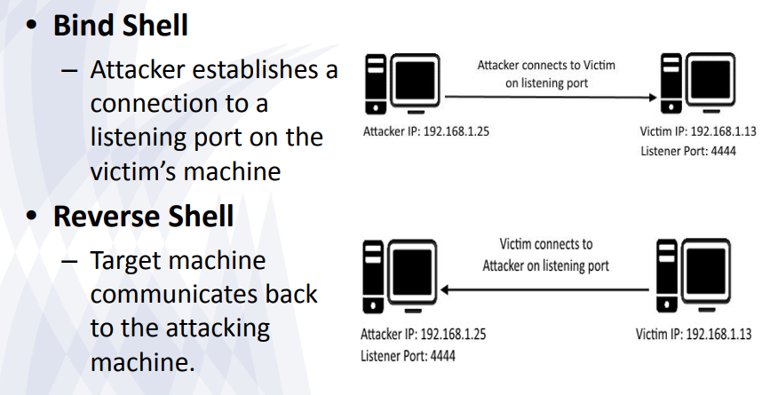
Types of Connection

Slide 26
Gaining Access Via Publicly Available Exploits
Attackers can use various exploit sites such as Exploit Database, SecurityFocus, etc. to discover vulnerabilities and download or develop exploits to perform remote exploitation on the target system. These sites include details of the latest vulnerabilities and exploits.

Slide 27
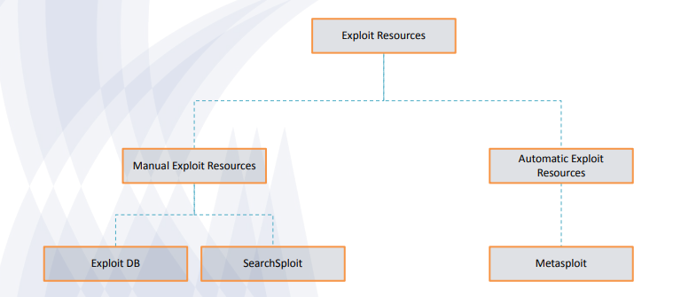
Understanding Exploit
Resources

Slide 28
Exploit DB & SearchSploit
Exploit DB - An online database containing exploits.
– https://www.exploit-db.com/
SearchSploit – command line search tool for finding exploits in locally saved repositories.

Slide 29
Metasploit Framework
It is a powerful tool which can be used to probe systematic vulnerabilities and perform security auditing on networks and servers.
It provides a wide array of commercial grade exploits that works in multiple platforms i.e. Linux, Windows, Android, PHP, Python, Java, Cisco, and more, nearly 500 payloads, network information gathering tools, web vulnerability plugins, among others.

Slide 30
Terminologies
Modules: A piece of software that can be used by Metasploit Framework.
Listener: component within Metasploit that waits for an incoming connection.
Exploit: A piece of code which, when executed, triggers the vulnerability at the target.
Listening Server/Service: A server or service that is configured to wait for connection. (TCP/UDP)
(-l listening mode, -v add verbosity, -p specify port no.)

Slide 31
Basic Exploitation w/
Metasploit
After finding a vulnerability with your tool of choice, search for its exploit on msfconsole.
– search eternalblue
Select a viable exploit (and examine it)
– info /path/to/chosen/exploit
Select it and set the appropriate values
– use /path/to/chosen/exploit
– show options (& set them appropriately)
Select a viable payload and set its options
– show payloads
– set payload /path/to /chosen/payload
– show options & set them as required
exploit/run

Slide 32
Privilege Escalation
Escalating privileges is the second stage of system hacking. Attackers use passwords obtained in the first step to gain access to the target system and then try to attain higher-level privileges in the system.
Privileges are a security role assigned to users for using specific programs, features, OSs, functions, files or codes, etc.
Attackers employ design flaws, programming errors, bugs, and configuration oversights in the OS and software application to gain administrative access to the network and its associated applications.

Slide 33
Privilege Escalation Using DDL Hijacking
Most Windows applications do not use the fully qualified path when loading an external DLL library; instead, they first search the directory from which they have been loaded.
Taking this as an advantage, if attackers can place a malicious DLL in the application directory, the application will execute the malicious DLL in place of the real DLL.
Attackers use tools such as Robber and PowerSploit to detect hijackable DLLs and perform DLL hijacking on the target system.

Slide 34
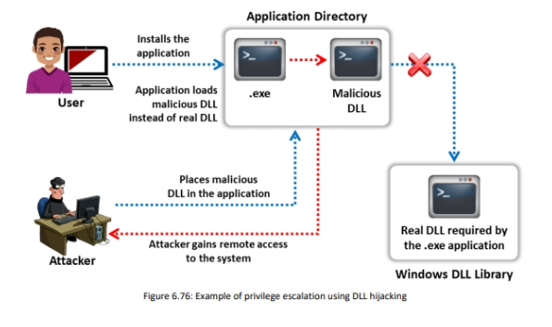
Privilege Escalation Using DDL Hijacking

Slide 35
Privilege Escalation by Exploiting Vulnerabilities
An attacker employs vulnerabilities to perform various attacks on the confidentiality, availability, or integrity of a system.
Attackers exploit these software vulnerabilities, such as programming flaws in a program or service, or within the OS software or kernel, to execute malicious code.
Exploiting software vulnerabilities allows attackers to execute a command or binary on a target machine to gain higher privileges than the existing ones or bypass security mechanisms.
Attackers using these exploits can even access privileged user accounts and credentials.

Slide 36
Privilege Escalation
Other Privilege escalation methods include:
Privilege Escalation using Named Pipe Impersonation.
Privilege Escalation using Spectre and Pipe Impersonation.
Privilege Escalation by Exploiting Misconfigured Services.
Access Token Manipulation.
Application Shimming.
Filesystem Permissions Weakness.
Path Interception.
Scheduled Task.
Kernel Exploits.

Slide 37
Maintaining Access
Attackers remotely execute malicious applications such as keyloggers, spyware, and other malicious programs to maintain their access to the target system and steal critical information such as usernames and passwords.
Attackers remotely execute malicious applications such as keyloggers, spyware, and other malicious programs to maintain their access to the target system and steal critical information such as usernames and passwords

Slide 38
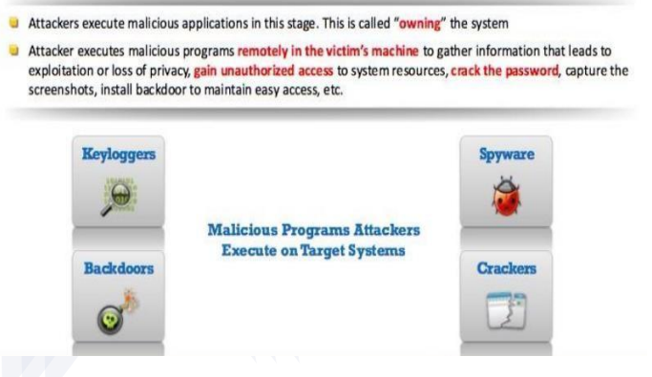
Maintaining Access

Slide 39
Hiding Files
Attackers remotely execute malicious applications such as keyloggers, spyware, and other malicious programs to maintain their access to the target system and steal critical information such as usernames and passwords.
Attackers remotely execute malicious applications such as keyloggers, spyware, and other malicious programs to maintain their access to the target system and steal critical information such as usernames and passwords

Slide 40
Hiding Files
Rootkits
NTFS Data Stream
Steganography

Slide 41
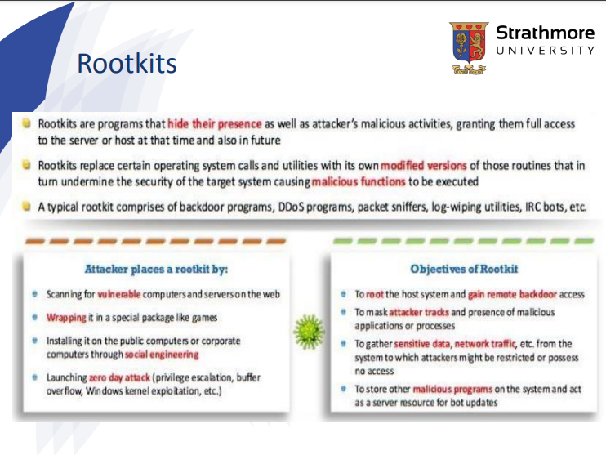

Slide 42
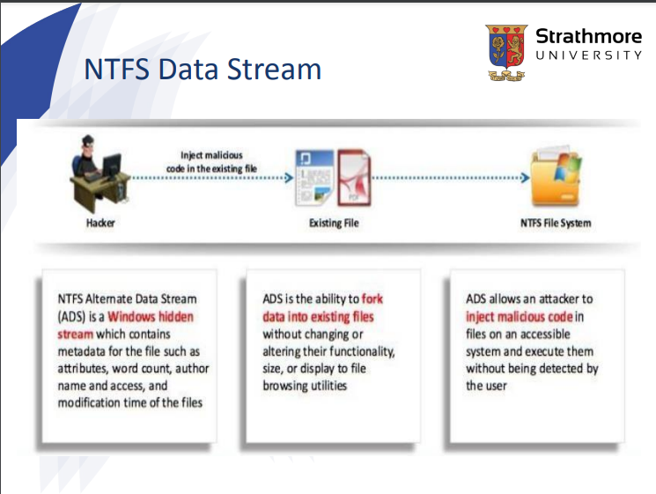

Slide 43
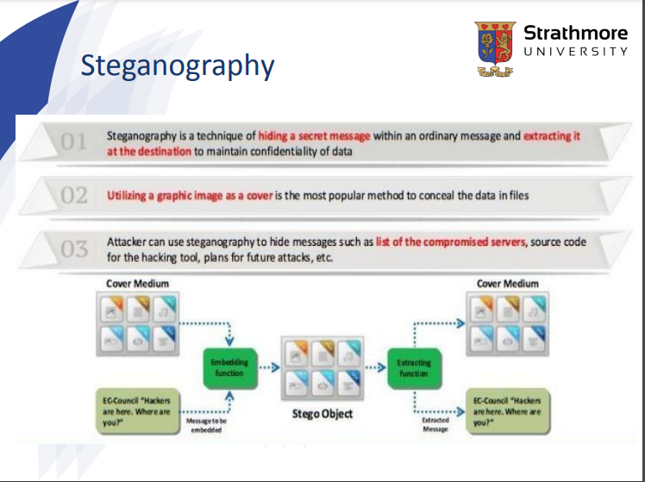

Slide 44
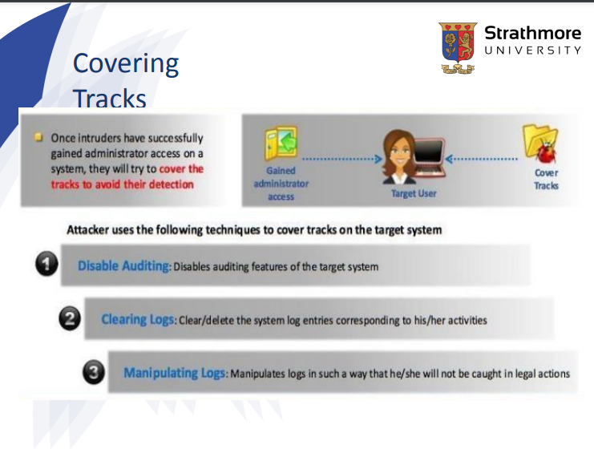

Slide 45
Thank you!
Any Questions?

